Slide 1


CAPSTONE PROJECT
Sales Forecasting Dashboard
Presented By
Student Name: Narayana Murari
College Name: malla reddy university
Department: Cse
Email ID: murari.xc.16@gmail.com

Slide 2
OUTLINE:
Problem Statement
Proposed System/Solution
System Development Approach
Algorithm & Deployment
Result (Output Image)
Conclusion
Future Scope
References

Slide 3
Problem Statement:
In today’s competitive market, businesses face the challenge of ensuring that products are available to customers at the right time and in the right quantity. Just as urban cities require a stable supply of rental bikes to meet hourly demand, sales teams must anticipate customer needs to minimize waiting time and avoid missed opportunities. The critical issue lies in predicting the required sales volume and inventory at each period to maintain a consistent supply. Without accurate forecasting, companies risk stockouts, overstocking, and dissatisfied customers, ultimately impacting revenue and brand trust. Therefore, developing a reliable system to predict sales demand and align it with inventory and distribution is essential for achieving stable and sustainable sales growth.

Slide 4
Proposed Solution:
Data Collection
Integrate historical sales data from ERP, CRM, or POS systems.
Connect external data sources such as promotional campaigns, competitor activity, seasonal trends, and economic indicators.
Data Preprocessing
Use Power Query in Power BI to clean and transform raw data, handling missing values, duplicates, and inconsistencies.
Apply calculated columns and measures (DAX) for feature engineering, such as sales per region, promotion impact, or seasonal demand factors.
Predictive Analytics
Integrate machine learning models into Power BI for demand forecasting.
Use time-series forecasting visuals to predict future sales trends.
Visualization & Reporting
Build interactive dashboards showing:
  Hourly/daily/weekly sales forecasts
  Regional and product-level performance
Result
The system will empower businesses with real-time, data-driven sales insights, enabling proactive decision-making, reduced stockouts/overstocking, optimized marketing strategies, and sustained revenue growth.

Slide 5
System Approach:
PowerBI
DAX formulas:
AvgDelivey = DATEDIFF('SuperStore_Sales_Dataset'[Order Date], 'SuperStore_Sales_Dataset'[Ship Date],DAY)
SalesForecast = SUMMARIZE('SuperStore_Sales_Dataset', 'SuperStore_Sales_Dataset'[Order Date], "Total Sales", SUM(SuperStore_Sales_Dataset[Sales]))

Slide 6
Algorithm & Deployment:
Algorithm Selection
A time-series forecasting model is chosen to predict future sales trends. This is suitable because sales data often shows seasonality, promotions, and regional variations.
Data Input
Historical sales records, product categories, regions, seasonal factors and external indicators like competitor activity or economic trends.
Training Process
The model is trained on cleaned historical data using Power Query and DAX in Power BI. Cross-validation and parameter tuning are applied to improve accuracy.
Prediction Process
The trained model generates forecasts visualized in Power BI dashboards. Real-time inputs such as ongoing promotions or live transactions are incorporated to update predictions dynamically.

Slide 7
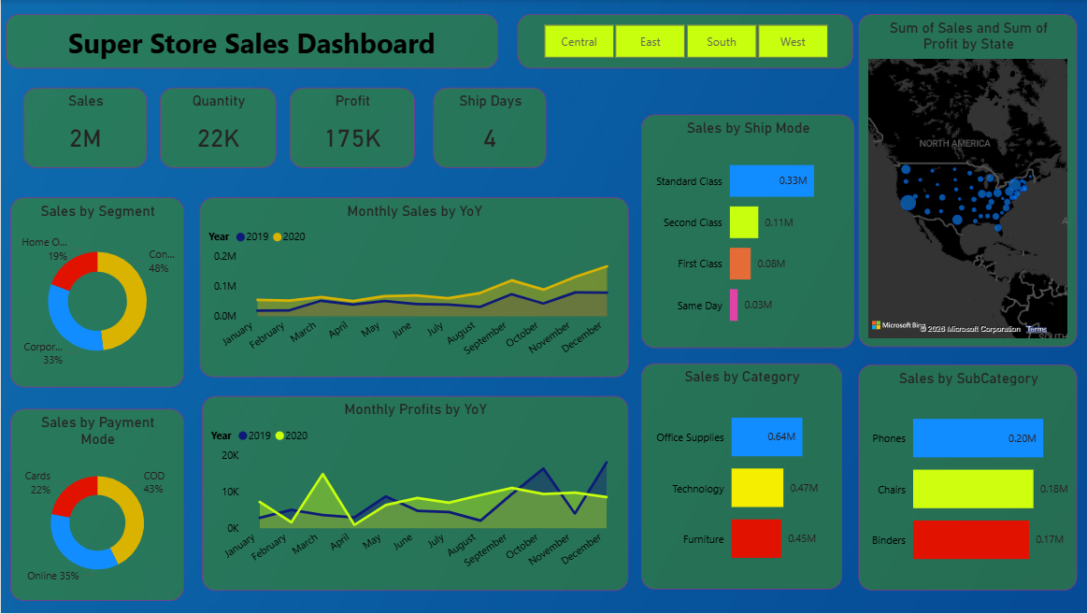
Result:

Slide 8
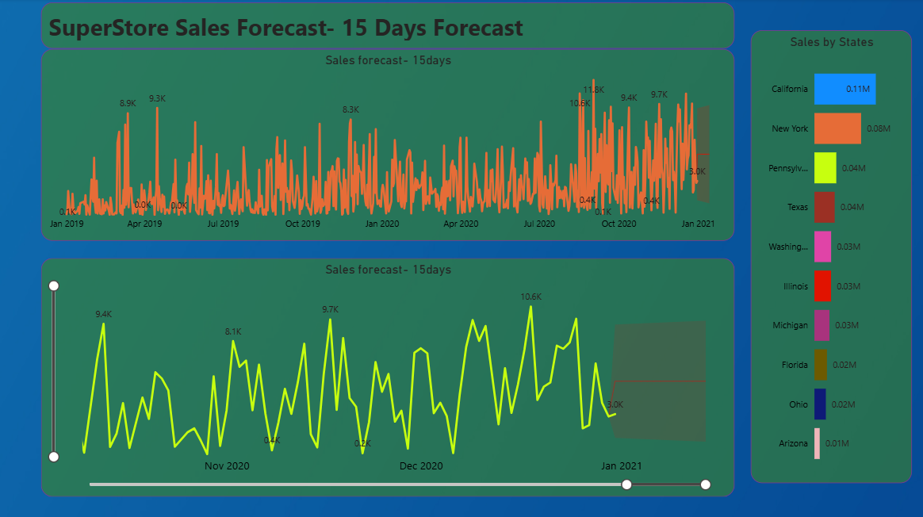
Result:

Slide 9
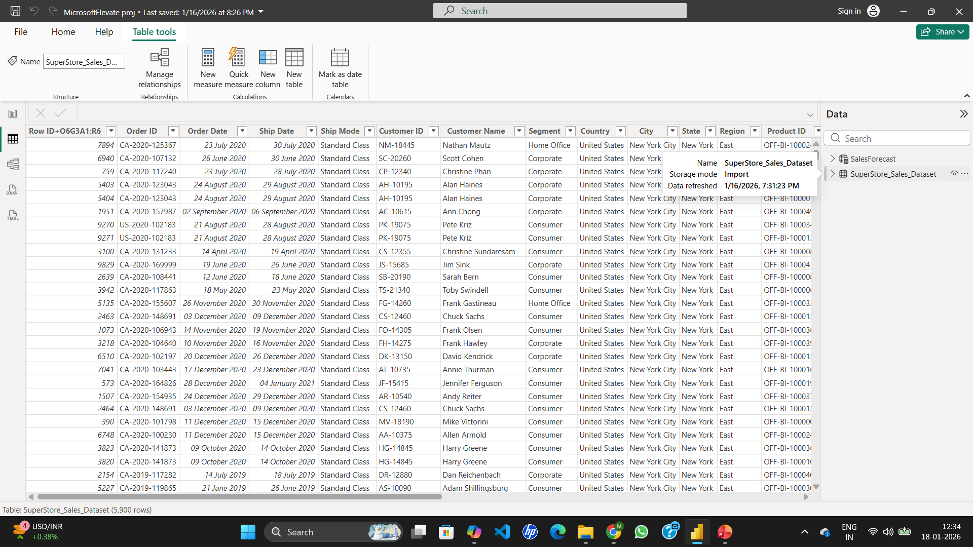
Result:

Slide 10
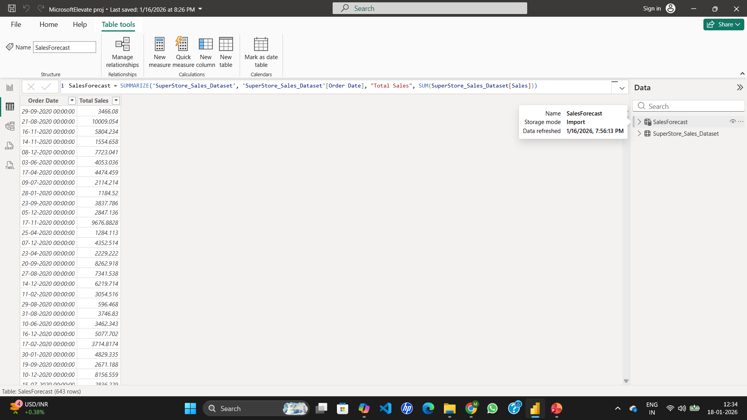
Result:

Slide 11
Conclusion:
The Power BI sales forecasting dashboard provides accurate, real-time insights into future demand, helping businesses optimize inventory and marketing strategies. While challenges such as data quality and model tuning were encountered, the solution proved effective in reducing stockouts and overstocking. Continuous refinement and integration with advanced models can further improve accuracy, making the dashboard a valuable tool for driving sustainable sales growth.

Slide 12
Future scope:
The dashboard can be enhanced by adding more data sources like customer behavior and competitor trends, optimizing forecasting models with advanced machine learning, and expanding coverage across multiple regions or product lines. Integration with emerging technologies such as edge computing and AI-driven anomaly detection will further improve accuracy and scalability..

Slide 13
References:
GitHub Link: Link
Youtube Link: Link
LinkedIn Link: Link

Slide 14
Thank You

